Slide 1


PROJECT CATASCHEVASTICA
An Online Transaction Database (OLTP)
TEAM 5
Giarmas Nikos
Kakalis Loukas
Michailidis Giorgos
Mistiloglou Charis
Tzimi Katerina

Slide 2


Cataschevastica
3
Executive Summary
8
SQL - Creating Database, Tables
Table of contents
4
Project Development Roles
9
SQL - Population of Tables
5
Key Points
10
SQL - Statements
6
ERD Diagram
11
Project Management Issues
7
SQL Relational Schema
12
Questions

Slide 3

Cataschevastica
Executive Summary
This project involves developing an Online Transaction Processing (OLTP) database for a fictional manufacturing company, Cataschevastica. The goal of this project is the development of a database that will manage the entire manufacturing process, from order intake and production to delivery, emphasizing customer satisfaction, operational efficiency, and service quality.

Slide 4

Project Development Roles
Business Analysts
Giarmas Nikos
Michailidis Georgios
Data Engineers
Mistiloglou Charalampos
Tzimi Katerina
Project Manager
Kakalis Loukas
Product Owner
Instructor

Slide 5
Cataschevastica
Key Points
Products construction
Create Product table
Create Raw materials’ table as they are essential for finished product’s construction
Create Suppliers table providing Raw materials
2. Orders procedure and delivery
Create Orders table
Create Customers table
Create Production team table which monitors the orders state
Create Order history table to log each order’s state over time
Create Order list table where all products of an order are contained

Slide 6
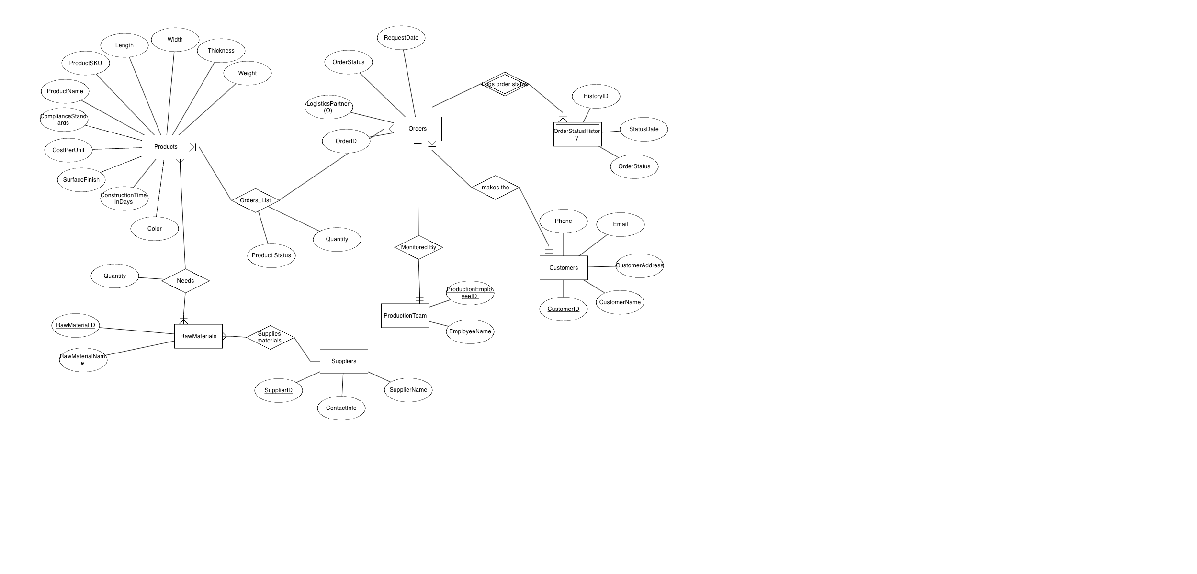

ERD Diagram
Cataschevastica

Slide 7
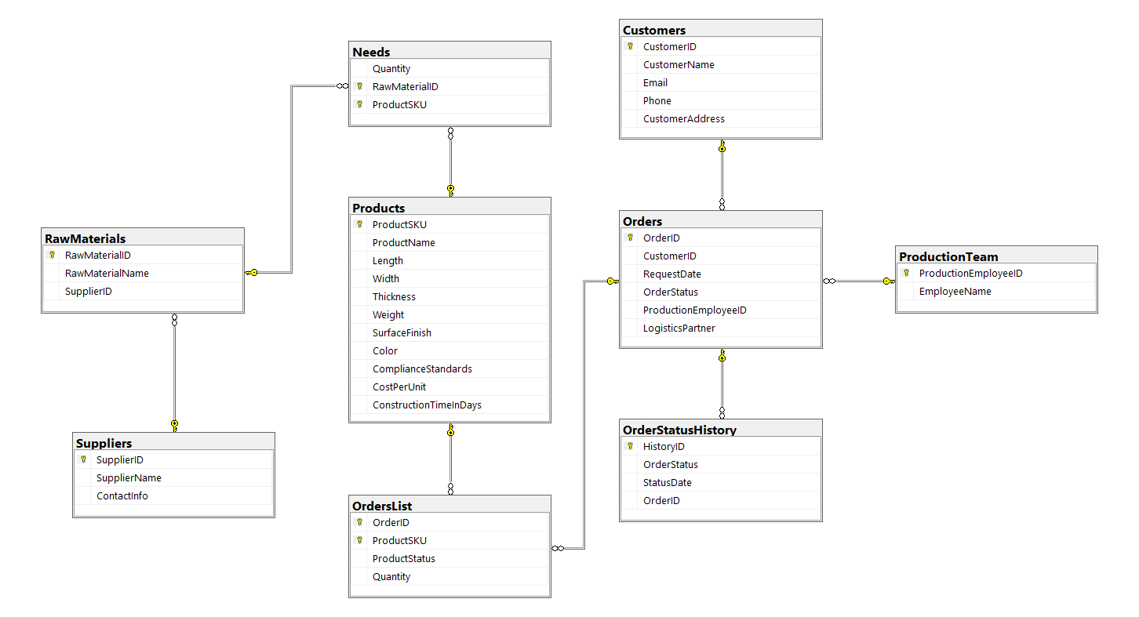
Cataschevastica
SQL Relational Schema

Slide 8
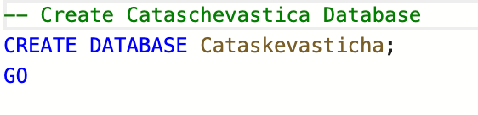
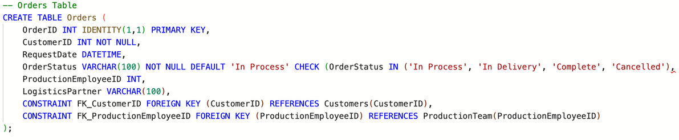
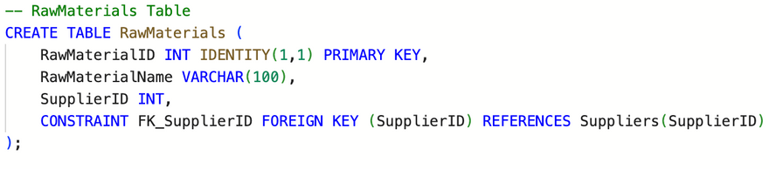
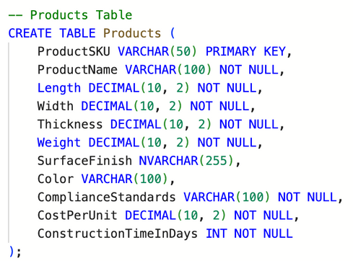
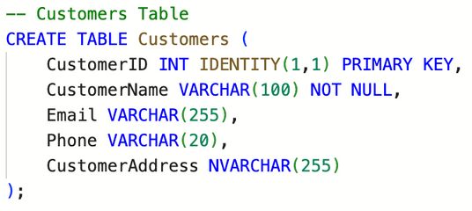
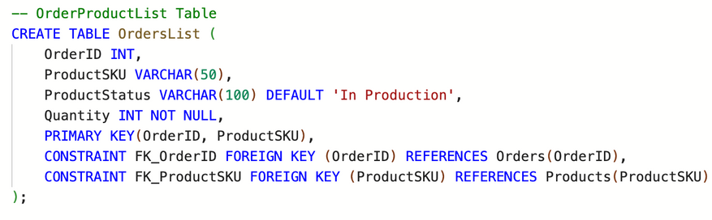
SQL - Creating database, tables
1st step - Creating the Database Cataschevastica
2nd step - Creating all the tables according to Entity Relationship Diagram

Slide 9
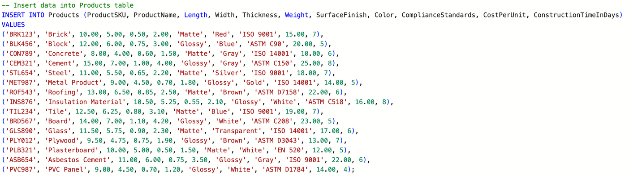
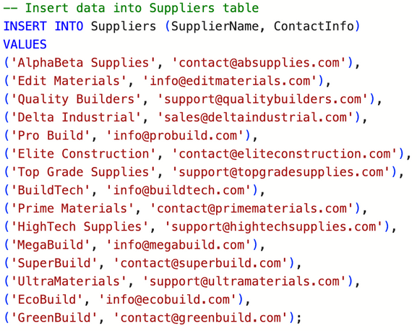
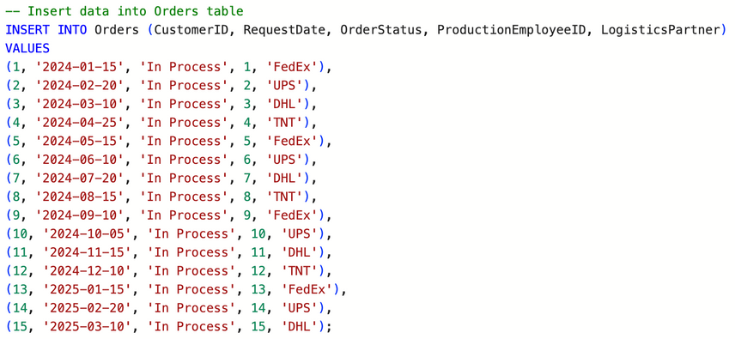
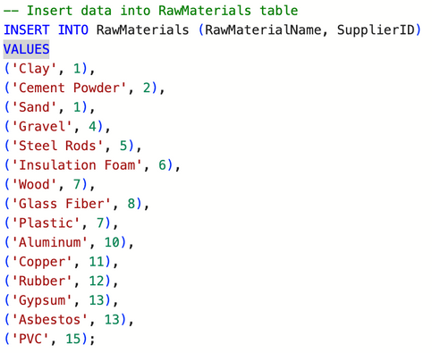
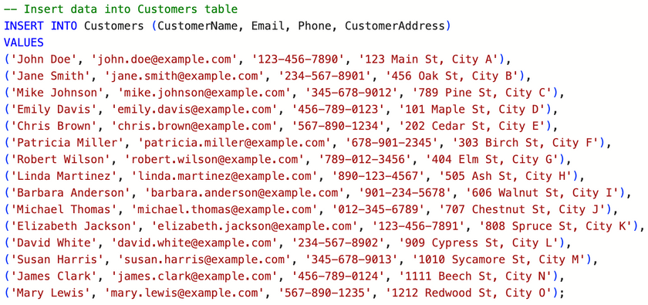
SQL - Populating tables
3rd Step - Populating the tables with data, 15 rows per table

Slide 10
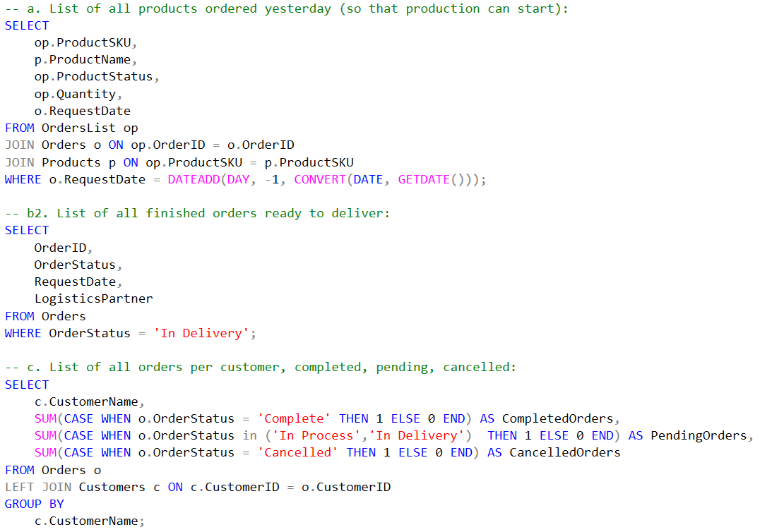
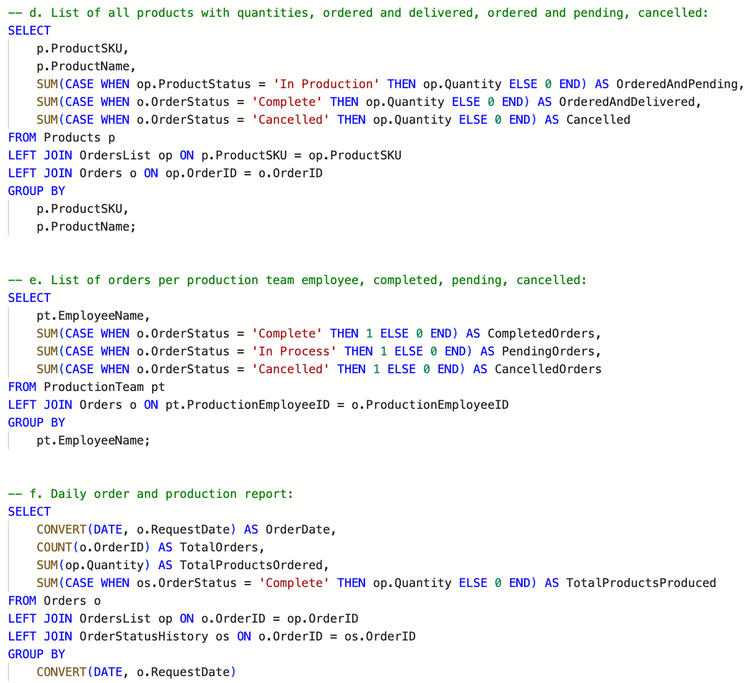
SQL Statements
4th Step - Quering the data

Slide 11
Project Management Issues
Time management. Struggle finding the right time for the meetings between all team members, as everyone works and we had different available times.
Issue regarding the Orders:
How to record the orders.
How to properly store and handle all the products that each order includes.
How to track the productions process for each product and the whole order.

Slide 12

Cataschevastica
Questions

Slide 13

Cataschevastica
Thank you!

